Slide 1
Open Source software development
Lecture #03: Commercial Open Source
Dr. Igor Steinmacher
e-mail: igorfs@utfpr.edu.br
Twitter: @igorsteinmacher

Slide 2
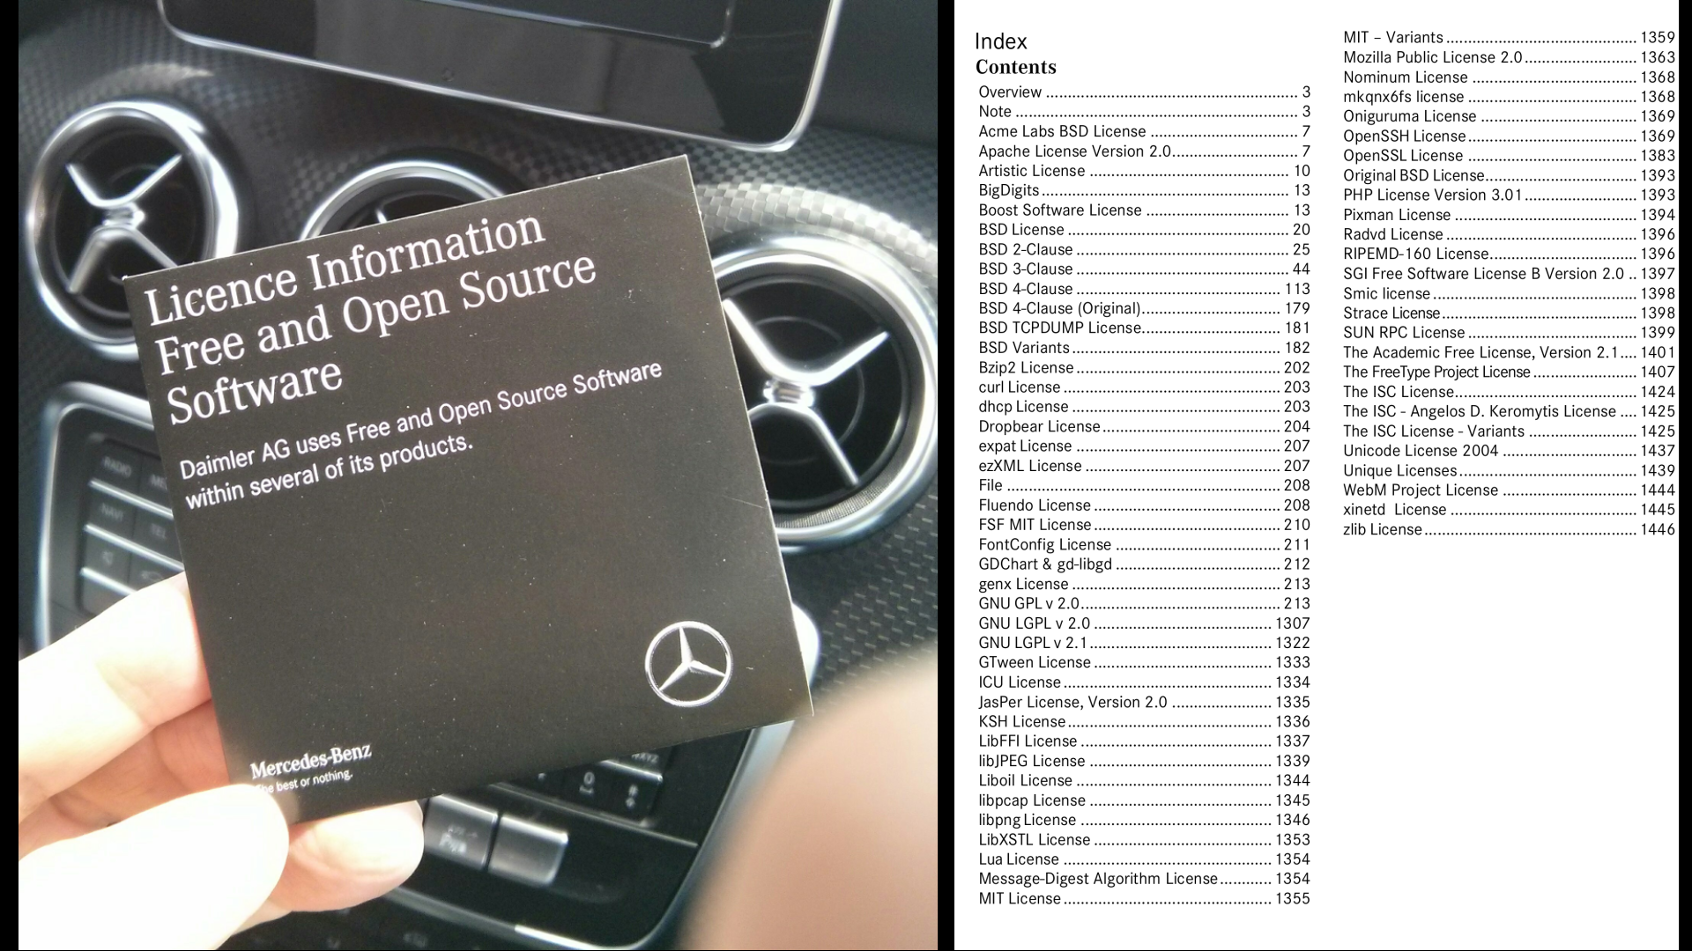

Slide 3
Community vs. Commercial Open Source
Open
(governance)
Closed
(company rules)
Process
Artifact vs. Process
Open
(Shared ownership)
Open
(IP is company-owned)
Artifact
Project
Product
Project vs. Product

Slide 4
Community vs. Commercial Open Source
Community open source
Traditional open source projects (e.g. GIMP)
Developer-led projects / foundations (e.g. Jakarta / Eclipse)
User-led projects / foundations (e.g. Kuali)
Commercial open source
Single-vendor open source firms (e.g. MongoDB)
Open source distributor firms (e.g. SUSE)
Service and support firms (e.g. Cygnus Solutions)

Slide 5
Commercial Open Source??
“Como criar um negócio que gire em torno do produto que estamos querendo abrir para a comunidade (de forma gratuita)?”
https://www.webiny.com/blog/what-is-commercial-open-source

Slide 6
Commercial Open Source??
Commercial open source software
Is open source software that
Is being developed by one or more software vendors
For the purposes of deriving indirect revenues from it
The product is never open source software
Customers pay for a basic or whole product
By a (the) commercial open source vendor

Slide 7
But, Why?
To drive adoption (of the product) due to (nearly) frictionless distribution
To build a large user base from which benefits accrue
To have an existing base of users to convert to customers
To hinder competitors from getting in
What is not new
Revenue sources
What is new
Everything else (changes)

Slide 8












Who??

Slide 9
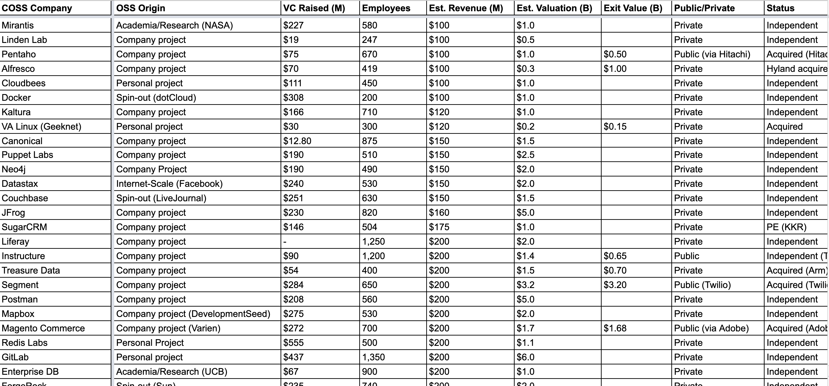
Who?
http://oss.cash

Slide 10
Core product =
Open source software
Additional functionality
Complementary artifacts
Self-help services
Basic product =
Core product +
Fitness for use
Certification
Support services
Whole product =
Basic product +
Training
Consulting
Operations
}
Sometimes commercial
}
Always commercial

Slide 11
An example…
Web Store
Direct Sales
DOC
Documentation
INC
Incident-based
support
Open Source Community
DOC
INC
UTIL
Utilities
UTIL
LIC
Commercial
license
Enterprise Customers
LIC
UPD
UTIL
DOC
TRN
24x7
UPD
Update service
TRN
Training
ISV / OEM
LIC
UTIL
...
DOC
TRN
24x7
24x7 hotline
24x7

Slide 12
Commercial Open Source by Intellectual Property
Commercial Open Source Startups
© 2021 Dirk Riehle - Some Rights Reserved
Single-vendor open source firms
Provide a traditional software product to enterprises
Exclusively own (key parts of) the software their business is based on
Can attract venture capital; can have outsize returns
Open source distributor firms
Provide a well working assembly of open source components
Exclusively own non-core-software IP (configuration data, regression test suites, …)
Can attract venture capital; can have outsize returns
Service and support firms
Service existing community open source software
Share in the IP, don’t dominate it
Don’t attract venture capital

Slide 13
Single-Vendor Open Source Firms

Slide 14
Definition of Single-Vendor Open Source
Single-vendor open source software is commercial open source software that
Is managed and developed by a single vendor
A single-vendor open source software firm is a software vendor that
Manages and develops single-vendor open source software

Slide 15
Characteristics of Single-Vendor Open Source
Single-vendor open source firms
Owns most or all of the key control mechanisms for open source
In particular, they are (by definition) the sole copyright owner
Can attract venture capital funding and can have outsize returns
Perhaps better be called neo-proprietary software vendors

Slide 16













First and Second Generation Single-Vendor Open Source Firms

Slide 17
















Third Generation Single-Vendor Open Source Firms

Slide 18
Community vs. Commercial Edition (Single-Vendor Firms)
Community edition
Core product
Core software
Provided under an open source license
Some complementary artifacts
Self-help services
Commercial edition
Core product
Core software
Provided under a commercial license
Additional functionality
Complementary artifacts
Self-help services
Basic product =
Core product +
Fitness for use
Certification
Support services
Whole product =
Basic product +
Training
Consulting
Operations

Slide 19
User to Customer Conversion
Commercial edition
Enterprise customer
Is willing to pay
Requires enterprise features
Internal IT department
Has appropriate budget
Wants professional support
Community edition
Home user
Will never pay money
But pays with time, feedback
Line-of-business user
Likes $0 line-items
May be ignorant of risks

Slide 20
Intellectual Property Management (Single-Vendor Firms)
[1] Riehle, D. (2009). The Intellectual Property Rights Imperative.
[2] All you really need is a relicensing right though
Intellectual property rights imperative (of single-vendor open source)
“Always act in such a way that you, and only you, possess the right to provide the open source project under a license of your choice.” [1]
Use contributor assignment to maintain ownership
Almost all single-vendor open source firms require copyright transfer for any contributions to maintain full IP ownership [2]

Slide 21




Multi-Vendor Commercial Open Source
Hadoop | Kafka | Lucene / Solr
Multi-vendor = no single dominant owner, rather shared control
If so, best under a foundation to ensure reasonable governance
Creates the problem of starving the project for new features

Slide 22
4. Open Source Distributor Firms

Slide 23
Definition of Open Source Distribution
An open source distribution
Is a well integrated collection of open source components and applications
An open source distributor firm
Is firm that provides an open source distribution as a product or service

Slide 24
Characteristics of an Open Source Distribution
An open source distribution is a complex software where complexity stems from
The number of components
The individual complexity of a component
Keeping the components working with each other
Keeping the components up-to-date
A commercial open source distributor hides this complexity from the user (for pay)

Slide 25











Examples of Open Source Distributor Firms
Linux
Kubernetes
Miscellaneous

Slide 26
Community vs. Commercial Edition (Distributor Firms)
Community edition
Example Linux-based distributions
Canonical
Ubuntu
Univention
Univention Corporate Server
Red Hat
Fedora, CentOS
Suse
OpenSuse
Product
Core product
Core software
Provided under its open source license
Complementary artifacts
Self-help services
Commercial edition
Example Linux-based distributions
Canonical
Ubuntu
Univention
Univention Corporate Server
Red Hat
Red Hat Enterprise Linux
Suse
Suse Linux Enterprise Server
Product and services
Core product
Core software
Provided under its open source license
Additional functionality
Provided under a commercial license
Complementary artifacts
Self-help services
Basic product
Whole product

Slide 27
Intellectual Property Management (Distributor Firms)
Distributor firms do not exclusively own the copyright to the code
Distributor firms can (and do) exclusively own
Build processes for building the product from its components
Compatibility matrices and configuration data
Knowledge databases for support
Tests and test suites
Distributors own “what’s in between” the open source code
Sometimes manifests itself exclusively in people

Slide 28
5. Service and Support Firms

Slide 29
Definition of Service and Support Firm
An open source service and support firm
Is a consulting firm that services and supports community open source software

Slide 30
Characteristics of Service and Support Firms
A service and support firm is a consulting firm
Revenues mostly scale with labor
These firms contribute to the open source project they support
Such positioning is important for marketing and sales

Slide 31
Open Source software development
Lecture #03: Commercial Open Source
Dr. Igor Steinmacher
e-mail: igorfs@utfpr.edu.br
Twitter: @igorsteinmacher

